Slide 1




DSA0199 - OBJECT ORIENTED PROGRAMING WITH C ++ USING ENCAPSULATION
Guided by
S JAYANTHI
BALAJI D 192211929))
BALAJI M 192211727)))

Slide 2


SLR Parsing
SLR (Simple LR) parsing is a powerful technique for recognizing and parsing context-free grammars. It leverages the LR parsing approach, providing a more efficient and deterministic method for analyzing language constructs.
by Balaji dasetti
by Balaji Mannam

Slide 3

Context and Motivation
SLR parsing finds applications in various areas, particularly compiler design, where it's crucial for analyzing and translating programming languages.
1
Efficiency
2
Error Detection
SLR parsing offers a more efficient and deterministic approach compared to other parsing methods, enabling faster and more reliable analysis of language constructs.
It effectively detects syntax errors in code, providing valuable feedback to developers for resolving issues and improving program quality.
3
Context-Free Grammars
SLR parsing works well with context-free grammars, a common representation for programming language syntax.

Slide 4
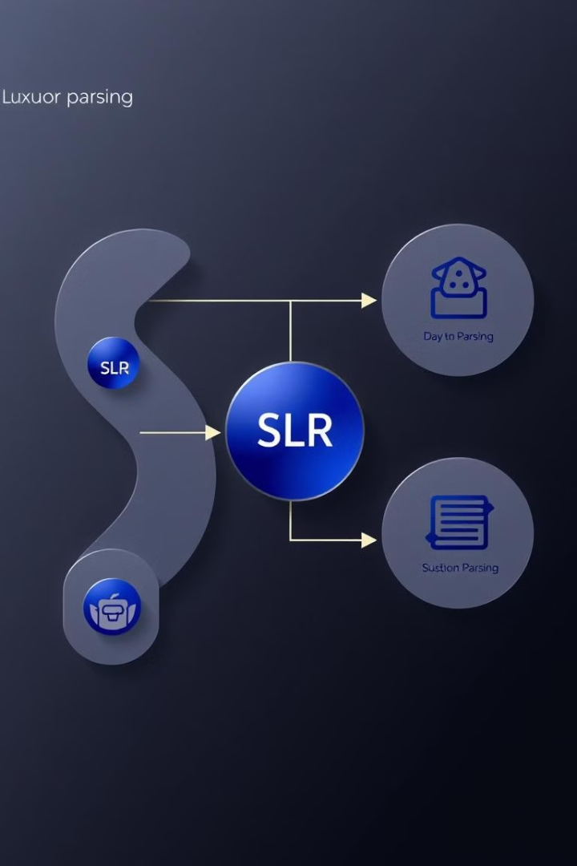
SLR Parsing Algorithm
The SLR parsing algorithm proceeds through a sequence of actions based on the current state and the input symbol.
1
Initialization
The parser starts in the initial state, with an empty stack and an input string.
2
Shift
If the current state and input symbol correspond to a shift action, the symbol is pushed onto the stack, and the state is updated.
3
Reduce
If a reduction is possible, the parser replaces the top symbols on the stack with the corresponding non-terminal, based on the grammar rules.
4
Acceptance
If the input is fully processed and the stack contains only the start symbol, the input is accepted.

Slide 5
SLR Parsing Table Construction
An SLR parsing table is constructed using the grammar rules and a set of states representing the possible configurations of the parser.
State
Action
Goto
Each row of the table represents a state of the parsing automaton.
The action part of the table specifies the actions (shift, reduce, or error) to take for each input symbol.
The goto part of the table indicates the next state to transition to when a non-terminal is encountered.

Slide 6
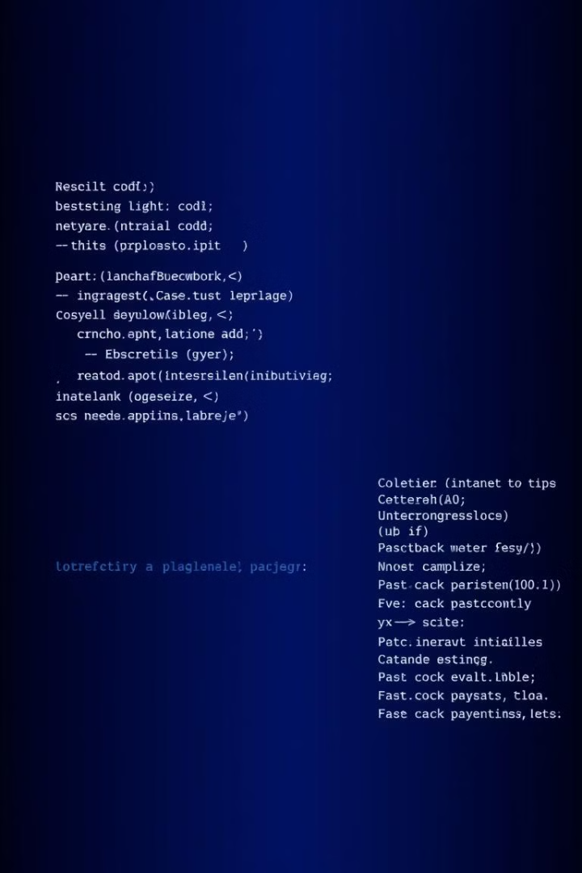




SLR Parsing Example
Let's consider a simple grammar and an input string to illustrate the SLR parsing process.
Input String
The input string to be parsed is "id + id * id".
Shift
The parser shifts the first symbol "id" onto the stack, updating the state.
Reduce
Upon encountering the "+" symbol, the parser reduces the top symbols on the stack (id) to a non-terminal "expression", based on the grammar rule.
Acceptance
The parser continues the process of shifting and reducing until the input is fully processed and the stack contains the start symbol, indicating successful parsing.

Slide 7
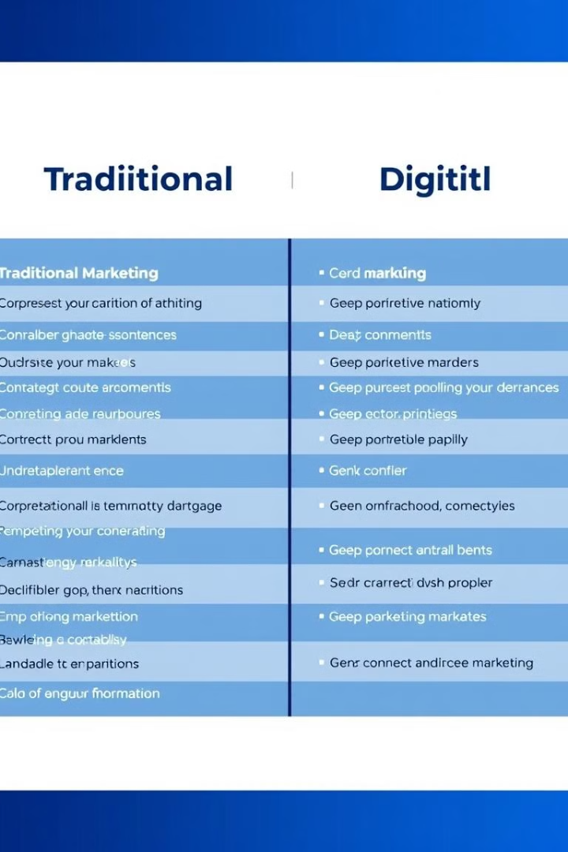
Advantages and Limitations of SLR Parsing
SLR parsing offers advantages in terms of its efficiency and error detection capabilities, but it also has limitations that need to be considered.
Advantages
Limitations
SLR parsing is relatively efficient and deterministic, making it suitable for compiler design.
SLR parsing may not be able to handle all context-free grammars, and it may require manual adjustments in some cases.

Slide 8




Conclusion and Future Directions
SLR parsing has proven to be a valuable tool for compiler design and language processing.
Further Research
Optimization
Applications
Continued research in parsing techniques aims to develop even more powerful and efficient algorithms that can handle complex language constructs.
Optimizations and enhancements to the SLR parsing algorithm can improve its performance and efficiency, leading to faster and more reliable parsing.
SLR parsing finds new applications in various domains, such as natural language processing, data analysis, and artificial intelligence.

Slide 9

Psudocode for slr parsing
The SLR parsing algorithm can be expressed in pseudocode for a clearer understanding of its logic.
function slr_parse(input_string, parsing_table): stack = [0] // Initial state input_pointer = 0 while True: state = stack[-1] symbol = input_string[input_pointer] action = parsing_table[state][symbol] if action == "shift": stack.append(symbol) stack.append(parsing_table[state][symbol]) input_pointer += 1 elif action == "reduce": // Perform reduction based on the rule // ... elif action == "accept": return "Parsing successful" else: // Error return "Syntax error"

Slide 10
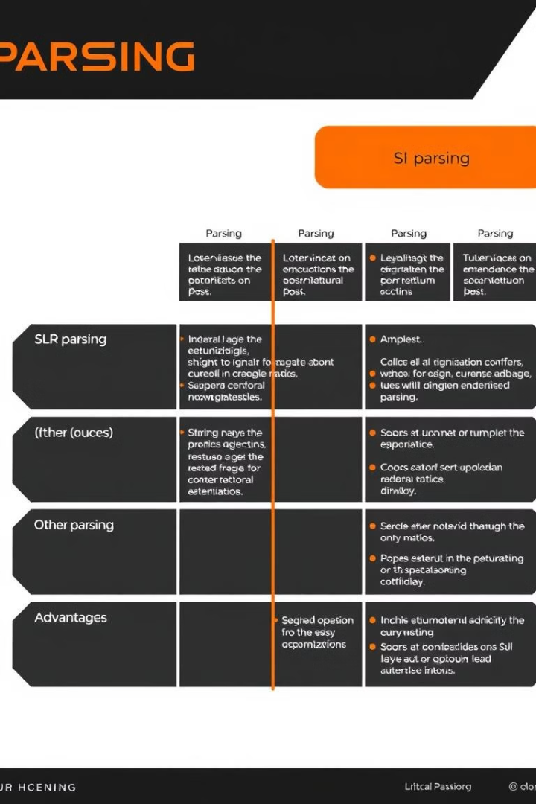
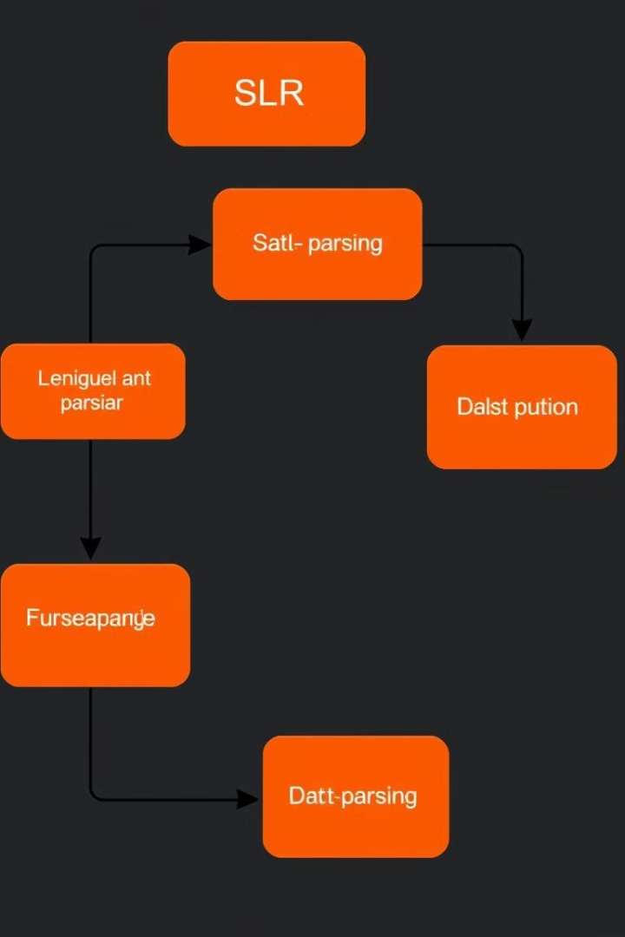
Limitations and Extensions of SLR Parsing
While SLR parsing is a widely used technique, it has limitations. Some grammars may be too complex for SLR parsing to handle effectively.

Slide 11
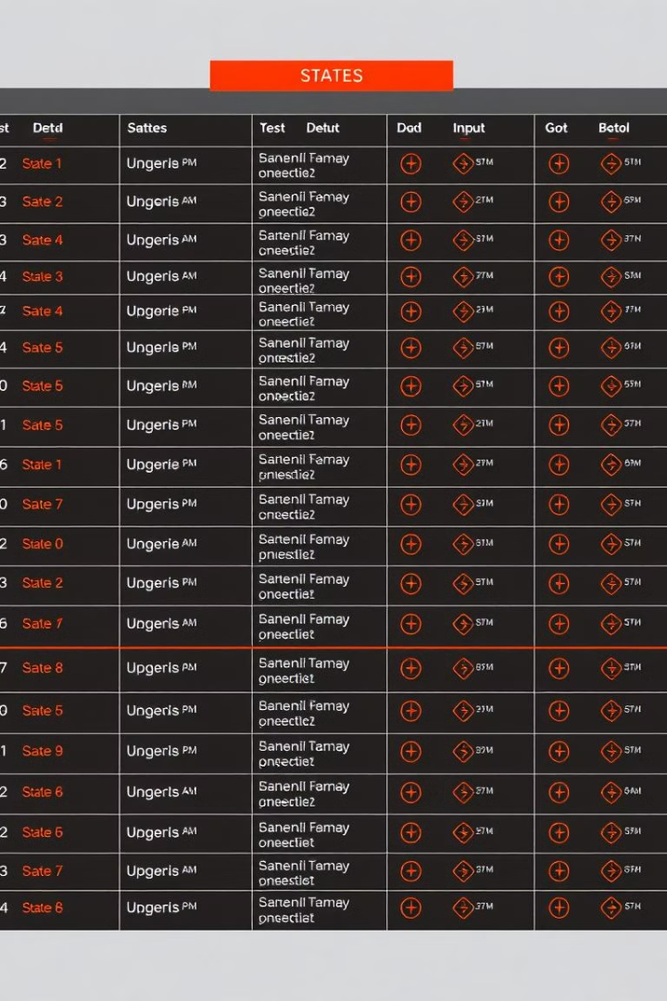
Constructing the SLR Parsing Table
The SLR parsing table is a key component of the SLR parsing algorithm. It contains information on actions and goto transitions for each state and input symbol.
SLR parsing is essential for constructing efficient and accurate compilers for various programming languages.
Interpreters use SLR parsing to analyze and execute program code line by line.
Text editors can use SLR parsing to provide syntax highlighting and error detection for various programming languages.
Databases can leverage SLR parsing for parsing and validating query languages.
The SLR parsing algorithm involves constructing a parsing table and using it to guide the parsing process. The algorithm iterates through the input tokens, making decisions based on the current state and the input symbol.

Slide 12

Context and Motivation
SLR parsing is a powerful tool for understanding the structure of programming languages. It enables efficient and robust parsing, ensuring correct interpretation of code.
Formal grammars provide a mathematical framework for defining the syntax of languages. Parsing involves analyzing an input string to determine if it conforms to the rules of a given grammar.
Grammar
A formal grammar consists of a set of symbols, production rules, and a start symbol.
Parsing
Parsing aims to construct a parse tree representing the syntactic structure of the input string.
SLR Parsing
SLR parsing is a bottom-up approach where the parser starts from the input tokens and gradually builds a parse tree.

Slide 13
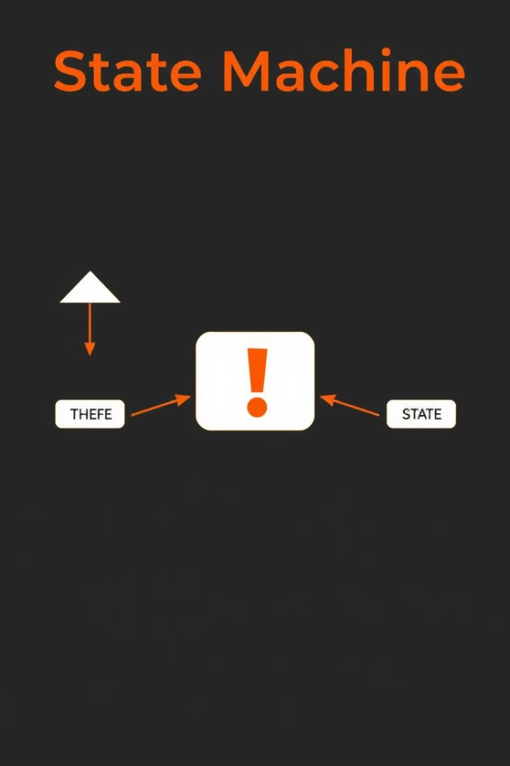



Handling Conflicts in SLR Parsing
Conflicts arise when the parsing table specifies multiple actions for a given state and input symbol. This situation can lead to ambiguities in parsing and errors in the output.
Shift-Reduce Conflict
Occurs when a state can either shift an input symbol or reduce a portion of the stack.
Reduce-Reduce Conflict
Occurs when a state can reduce the stack using multiple production rules.
Conflict Resolution
SLR parsing uses a simple conflict resolution strategy, but it may not always be effective in handling all conflicts.

Slide 14


Practical Considerations and Applications
SLR parsing plays a crucial role in compiler design, providing a foundation for language processing and analysis. It is a powerful tool for understanding and interpreting program code.
Compilers
Interpreters
SLR parsing is essential for constructing efficient and accurate compilers for various programming languages.
Interpreters use SLR parsing to analyze and execute program code line by line.
Text Editors
Databases
Text editors can use SLR parsing to provide syntax highlighting and error detection for various programming languages.
Databases can leverage SLR parsing for parsing and validating query languages.

Slide 15
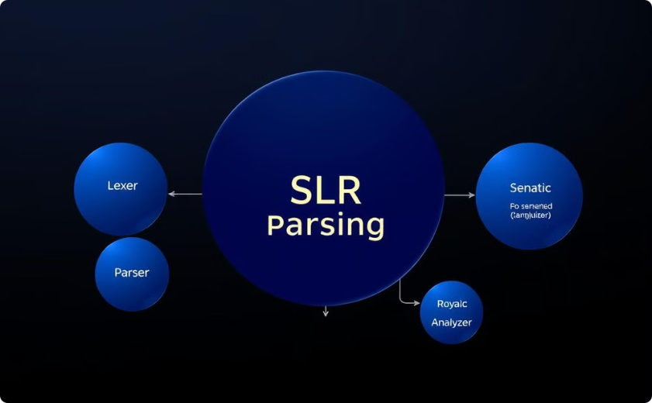
Applications
SLR parsing finds extensive applications in compiler design, software development, and related fields.
Compiler Design
Language Processing
SLR parsing is a core component in compiler design, ensuring accurate analysis and translation of programming languages.
SLR parsing is used in various language processing tasks, such as natural language processing, text analysis, and code understanding.

